Slide 1
Enhanced RACI Technique
Accountability, Clarity and Peace –
Plus Communication
SPEAKER:
THEA SOEHREN

Slide 2
Who is Thea Soehren
Thea Soehren
President of the IIBA Tampa Bay, Florida Chapter
And
VP of Career and Professional Development
Founder of the BA Force Multiplier movement
Author of the Business Analysis Body of Knowledge v3
Business Analysis Bridging the Gap Between Industries
President of the Tampa Bay, Florida Chapter of the IIBA
Contact Thea through LinkedIn –
https://www.linkedin.com/in/TheaSoehren/

Slide 3
The ISNT just the RACI we were taught.
I have used these additions and techniques to successfully lead all types of meetings, even the HARDEST and most contentious.
You need everyone to leave the meeting with the SAME ideas, understanding what they committed to, when they will deliver, who will be involved, and exactly what decisions were agreed to (and by whom).
This tool/technique WORKS!
In addition to the RACI, I bring a few considerations based upon personality types, love languages and communication theories.

Slide 4
AGENDA
Accountability, Clarity and Peace
BABOK® 10.39 Roles and Permissions Matrix
RACI as it was
The RACI Method I use to bring Accountability, Clarity and Peace
Let’s Practice!
Other RACI versions
Personalities and Appreciation

Slide 5
Accountability, Clarity and Peace
Accountability
Clarity
Peace
…that’s a tall order.

Slide 6
Bad meetings
Do you have this at work?
Let’s talk about running a meeting.
How many times…..

Slide 7
Bad meetings

Slide 8
Bad meetings

Slide 9
Bad meetings

Slide 10
International Institute of Business Analysis™ (IIBA®)
A Guide to the Business Analysis Body of Knowledge® (BABOK® Guide)
Notes:
When we wrote the BABOK 10 years ago, RACI was included in the Roles and Permissions Matrix technique section.
The purpose is the same –
“Ensure coverage of activities by denoting responsibility to identify roles, to discover missing roles and communicate results of planned change.”

Slide 11
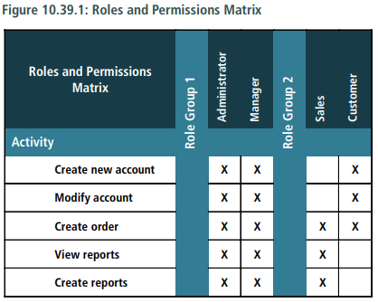
From the BABOK
Only two conditions are identified –
either
Does Apply
Or
Does NOT Apply
Notes:
But for a Roles and Permissions Matrix, that covers only a yes or no –
Does this condition apply or not to this stakeholder or user group

Slide 12
From the BABOK
Responsible Accountable Consulted Informed
Notes:
With the RACI, we bring in specific conditions that remove ambiguity

Slide 13
Meeting level raci
RACI Matrix
Task | John Product Owner | Beth QA Manual Test | Dixon UI Designer | Parth QA Automated Testing | Andrew JAVA Dev
Notes:
This is the RACI you may know –

Slide 14
Meeting level raci
RACI Matrix
Task | John Product Owner | Beth QA Manual Test | Dixon UI Designer | Parth QA Automated Testing | Andrew JAVA Dev
Notes:
An area for a task to be listed,

Slide 15
Meeting level raci
RACI Matrix
Task | John Product Owner | Beth QA Manual Test | Dixon UI Designer | Parth QA Automated Testing | Andrew JAVA Dev
Notes:
And columns for individual’s names

Slide 16
Meeting level raci
RACI Matrix
Responsible Accountable Consulted Informed
Responsible – These are the people who will do the work.
Accountable – This is the ONE person who will be sure the task is completed.
Consulted (before the event) - This person wants to have a say in some aspect of the event – it is best to note what specifically they want to be involved so you bring them in at the right time.
Informed (after the event) - This person wants to be told when some portion of the event has happened (and may want to also receive information about the results) – it is best to note what specific information they desire.
Notes:
RACI is an acronym and stands for:
Responsible – These are the people who will do the work.
Accountable – This is the ONE person who will be sure the task is completed.
Consulted (before the event) - This person wants to have a say in some aspect of the event – it is best to note what specifically they want to be involved so you bring them in at the right time.
Informed (after the event) - This person wants to be told when some portion of the event has happened (and may want to also receive information about the results) – it is best to note what specific information they desire.

Slide 17
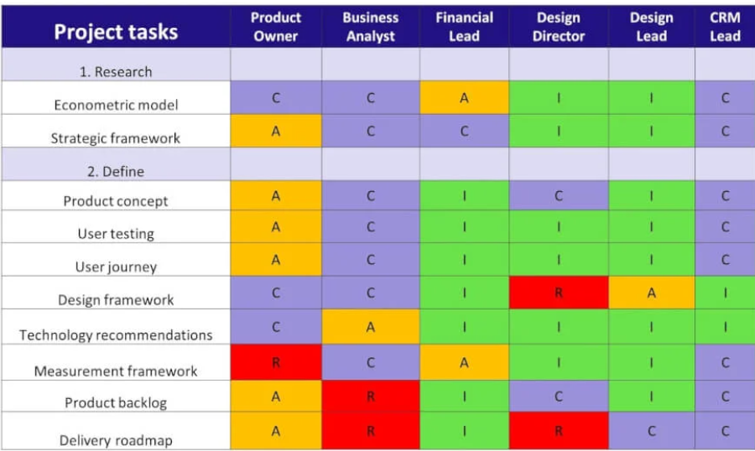
Project Level Raci
Responsible Accountable Consulted Informed
https://thedigitalprojectmanager.com/raci-chart-made-simple/
Notes:
You may have seen a RACI used at a project level
In this example,
You will see the project tasks,
Organized by project stage,

Slide 18
Project Level Raci
Responsible Accountable Consulted Informed
https://thedigitalprojectmanager.com/raci-chart-made-simple/
Notes:
Lets look at Product Backlog in the Define stage –
The Product Owner is accountable – as indicated by the A
The Business Analyst is Responsible – the R
The Design Director and CRM Lead are to be Consulted
And the Financial Lead and the Design Lead are to be Informed
You will notice there is nothing here to tell you any specifics as to what those who are to be consulted or informed want to know – so …everything?
Kind of ambiguous….

Slide 19
Meeting level raci
RACI Matrix –
Six Critical Stages
Responsible Accountable Consulted Informed
Stage 1 – Planning and Agenda
Stage 2 – Meeting Beginning
Stage 3 – Conduct Meeting/RACI
Stage 4 – Meeting Wrap up
Stage 5 – Send Out and Post
Stage 6 – Follow up / Update
Notes:
RACI for a Meeting
RACI can be used for a project level OR at a meeting level –
what we are doing today covers RACI at a meeting level.
YOU can use this for any meeting there are either decisions made and/or where tasks are to be completed.
In creating your RACI
There are Six critical stages

Slide 20
Meeting level raci
RACI Matrix –
Six Critical Stages
Responsible Accountable Consulted Informed
Stage 1 – Planning and Agenda
Stage 2 – Meeting Beginning
Stage 3 – Conduct Meeting/RACI
Stage 4 – Meeting Wrap up
Stage 5 – Send Out and Post
Stage 6 – Follow up / Update
Notes:
Stage 1 – Planning and Agenda
Before your meeting -
1. Identify your Goal for the meeting, What is in Scope and What is out of Scope.
2. Think about what your participants need to be told before the meeting to orient them to the situation and get them to laser focus on the goals of the meeting (this may include details, and information to set the stage, etc.).

Slide 21
Raci - Everyone On The Same Page With The Same Goal
Let’s Practice
Scenario – We all are in the same company, in the same department.
The Department outing has been planned for March 21st, for each of us and our family members (50 people total – list has been confirmed and all waivers signed and returned to HR).
We will meet at the office and be brought back to the office at the end of the day.
We will depart and return to the employee parking lot (pull out at 9am and arrive back at 5pm).
The signed contract / destination is Cowboy Ranch, located 30 minutes away from the office.
The Cowboy Ranch will provide the buildings, restrooms, activities with the horses and cowboys, but no food, games, or anything else.
The Cowboy Ranch is a large property and a circle drive in front of the main building, and there is shade at the circle drive.
We have an unlimited event budget allocated.
There are no holidays between now and the date of the event.
Notes:
Scenario – We all are in the same company, in the same department.
I have been given charge of getting the department outing scheduled and arranged.
I have the basics organized and now need help from YOU.
The department outing has been planned for March 21st, for each of us and our family members (50 people total – list has been confirmed and all waivers signed and returned to HR).
We will meet at the office and be brought back to the office at the end of the day.
We will depart and return to the employee parking lot (pull out at 9am and arrive back at 5pm).
The signed contract / destination is Cowboy Ranch, located 30 minutes away from the office.
The Cowboy Ranch will provide the buildings, restrooms, activities with the horses and cowboys, but no food, games, or anything else.
The Cowboy Ranch is a large property and a circle drive in front of the main building, and there is shade at the circle drive.
We have an unlimited event budget allocated.
For scheduling / work load purposes, I have checked and there are no holidays between now and the date of the event.

Slide 22
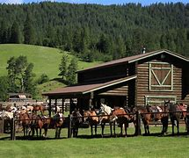
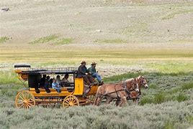
Raci - Everyone On The Same Page With The Same Goal
Notes:
RACI for a Meeting
RACI can be used for a project level OR at a meeting level – this covers RACI at a meeting level.
RACI is an acronym and stands for:
Responsible – These are the people who will do the work.
Accountable – This is the ONE person who will be sure the task is completed.
Consulted (before the event) - This person wants to have a say in some aspect of the event – it is best to note what specifically they want to be involved so you bring them in at the right time.
Informed (after the event) - This person wants to be told when some portion of the event has happened (and may want to also receive information about the results).
Columns in your RACI:
The specific goal(s) and scope of the meeting (to orient everyone as to what is to be accomplished).
Task/Decision - This allows you to note both Tasks AND Decisions (and indicate who was involved in the decision-making process.)
Date Due – A specific date/time
Received by WHOM Via (method) - specify the person or group who will receive the task AND the way the task is to be delivered (WHICH Teams folder, Email, in person, etc.)
Next Step / Notes – If a task must be completed as a predecessor to a different task, list the successor task here. If there are notes that do not quality as task but are important to note, list them here as well.
A column for EACH person involved – include the name AND their role or title. This allows you to find a new person to handle the task should a person is lost from the project.

Slide 23
Raci - Everyone On The Same Page With The Same Goal
Keep Everyone On The Same Page
Using a RACI Matrix
GOAL of this Meeting:
SCOPE of this Meeting (In and Out):
Notes:
So I am going to begin by defining
The goal of the meeting
The scope of what will be included in this meeting
And identify what is OUT of Scope for this meeting

Slide 24
Raci - Everyone On The Same Page With The Same Goal
RACI Matrix – Let’s Practice
Goal of this Meeting: | Department Outing Friday, March 21st, Friday, 9-5
Scope of This Meeting: | Determine: Communication, Transportation, Games, Food, What Else?
Out of Scope: | 50 people (list confirmed and participant waivers signed & received), Destination Identified and paid, Event Budget Allocated: Unlimited, Date/Time 03/21, 9-5, Leaving from and returning to office (employee parking lot)
Scenario – We all are in the same company, in the same department.
The Department outing has been planned for March 21st, for each of us and our family members (50 people total – list has been confirmed and all waivers signed and returned to HR).
We will meet at the office and be brought back to the office at the end of the day.
We will depart and return to the employee parking lot (pull out at 9am and arrive back at 5pm).
The signed contract / destination is Cowboy Ranch, located 30 minutes away from the office.
The Cowboy Ranch will provide the buildings, restrooms, activities with the horses and cowboys, but no food, games, or anything else.
The Cowboy Ranch is a large property and a circle drive in front of the main building, and there is shade at the circle drive.
We have an unlimited event budget allocated.
There are no holidays between now and the date of the event.
Notes:
Goal of this Meeting:
Department Outing Friday, March 21st, Friday, 9-5
Scope of This Meeting:
Determine: Communication, Transportation, Games, Food, What Else?
Out of Scope:
50 people (list confirmed), Destination Identified and paid, Budget Allocated,
Date/Time 03/07, 9-5, Leaving from and returning to office (employee parking lot)

Slide 25
Raci - Everyone On The Same Page With The Same Goal
Goal of this Meeting: | Department Outing Friday, March 21st, Friday, 9-5
Scope of This Meeting: | Determine: Communication, Transportation, Games, Food, What Else?
Out of Scope: | 50 people (list confirmed and participant waivers signed & received), Destination Identified and paid, Event Budget Allocated: Unlimited, Date/Time 03/21, 9-5, Leaving from and returning to office (employee parking lot)
Task / Decision | Date /Time Due | Received by WHOM Via (method) | Notes / Next Successor | Resolution | John Product Owner | Beth QA Manual Test | Dixon UI Designer | Parth QA Automated Testing | Andy JAVA Dev
Notes:
3. Create your RACI in a shared location; Ideally, a platform that will send a notification when updates are made to the document.
You will notice the yellow highlights – these are things I have added to the RACI over the years –
We will go over it in detail in a few minutes.

Slide 26
Raci - Everyone On The Same Page With The Same Goal
FOCUS OF THIS MEETING: | Department Outing, Scheduled for Friday, March 21, 9-5
SCOPE OF THIS MEETING: | Determine and assign the details for: Communication Transportation Games Food (what else?)
Out of SCOPE (Decisions already in place): | Number of people: 50 people, department employees and family members
 | Participants (50 people) have all signed waivers, and HR has the signed waivers
 | Event Budget: This event has an unlimited budget - approved and in place
 | Transportation: Leaving at 9am from the employee parking lot, circle drive Returning at 5pm to the employee parking lot, circle drive
 | Destination: Cowboy Ranch, located 30 min from the office, is under contract/paid
Details about Cowboy Ranch: | 30+ horses are available to ride
 | Instructors are on site to teach horsemanship
 | Trail rides (3 guides to 10 guests) will depart on the EASY Trail every hour from 10am until 3 pm
 | Trail rides (2 guides to 5 guests) will depart on the CHALLENGE Trail at 11am and 1pm.
 | Challenge Trail participants must pass a horsemanship test prior to departure.
 | Depending upon availaibity:
 | A roping demonstration may take place at 12:30 (after lunch)
 | Wigon rides may take place at 10am, 1pm, 2pm and 3pm
Notes:
4. Craft your email / meeting invitation.
In the subject and body of your meeting invitation:
FOCUS OF THIS MEETING: Department Outing, Scheduled for Friday, March 21, 9-5
SCOPE OF THIS MEETING: Determine and assign the details for: Communication Transportation Games Food (what else?)

Slide 27
Raci - Everyone On The Same Page With The Same Goal
Out of SCOPE (Decisions already in place): | Number of people: 50 people, department employees and family members
 | Participants (50 people) have all signed waivers, and HR has the signed waivers
 | Event Budget: This event has an unlimited budget - approved and in place
 | Transportation: Leaving at 9am from the employee parking lot, circle drive Returning at 5pm to the employee parking lot, circle drive
 | Destination: Cowboy Ranch, located 30 min from the office, is under contract/paid
Details about Cowboy Ranch: | 30+ horses are available to ride
 | Instructors are on site to teach horsemanship
 | Trail rides (3 guides to 10 guests) will depart on the EASY Trail every hour from 10am until 3 pm
 | Trail rides (2 guides to 5 guests) will depart on the CHALLENGE Trail at 11am and 1pm.
 | Challenge Trail participants must pass a horsemanship test prior to departure.
 | Depending upon availaibity:
 | A roping demonstration may take place at 12:30 (after lunch)
 | Wagon rides may take place at 10am, 1pm, 2pm and 3pm
Notes:
Give them the out of scope too – You do this so that people realize these decisions have already been made.
Out of SCOPE (Decisions already in place):
Number of people: 50 people, department employees and family members
Participants (50 people) have all signed waivers and HR has the signed waivers
Event Budget: This event has an unlimited budget - approved and in place
Transportation: Leaving at 9am from the employee parking lot, circle drive Returning at 5pm to the employee parking lot, circle drive
Destination: Cowboy Ranch, located 30 min from the office, is under contract/paid

Slide 28
Raci - Everyone On The Same Page With The Same Goal
Notes:
Think about what else you may be able to provide to your participants to help them focus on the event.
Many people are visual thinkers, so giving this pictures of the location will get them in “the right mind” and make it real to them.

Slide 29
Raci - Everyone On The Same Page With The Same Goal
Goal of this Meeting: | Department Outing – Cowboy Ranch - Friday, March 21st, Friday, 9-5
Scope of This Meeting: | Determine: Communication, Transportation, Games, Food, What Else?
Out of Scope: | 50 people (list confirmed and participant waivers signed & received), Destination Identified and paid, Event Budget Allocated: Unlimited, Date/Time 03/21, 9-5, Leaving from and returning to office (employee parking lot)
Task / Decision | Date /Time Due | Received by WHOM Via (method) | Notes / Next Successor | Resolution | John Product Owner | Beth QA Manual Test | Dixon UI Designer | Parth QA Automated Testing | Andy JAVA Dev
Notes:
Here is the initial RACI I create before the meeting.
You may notice I have added a quick calendar on the page because
we will have “what date will that be” questions and
this keeps them from having to look away from the screen.

Slide 30
Meeting level raci
RACI Matrix
Responsible Accountable Consulted Informed
Responsible – These are the people who will do the work.
Accountable – This is the ONE person who will be sure the task is completed.
Consulted (before the event) - This person wants to have a say in some aspect of the event – it is best to note what specifically they want to be involved so you bring them in at the right time.
Informed (after the event) - This person wants to be told when some portion of the event has happened (and may want to also receive information about the results) – it is best to note what specific information they desire.
Notes:
Before you send that meeting, consider this….
If you feel that the participants are not familiar and comfortable with a RACI,
Tell them you will be using a RACI during the meeting to document tasks and decisions
And include this information with the invitation, perhaps as an attachment.

Slide 31
Meeting level raci
RACI Matrix –
Six Critical Stages
Responsible Accountable Consulted Informed
Stage 1 – Planning and Agenda
Stage 2 – Meeting Beginning
Stage 3 – Conduct Meeting/RACI
Stage 4 – Meeting Wrap up
Stage 5 – Send Out and Post
Stage 6 – Follow up / Update
Notes:
So you have sent out the meeting invites, and the meeting is about to start.
Stage 2 – Meeting Beginning
Have the RACI up on the screen at the beginning of the meeting.
1. Beginning the meeting, tell the participants you will be using a RACI to track the decisions and tasks identified.
2. Explain the RACI acronym (above).
3. Explain the results of this meeting will all be recorded on the RACI, including the resolution of each task.
4. Explain the RACI will be sent out to "all impacted parties, the meeting participants and others interested in this meeting.”
5. Show them their names across the top - because their input is valuable.
6. Keep the RACI on the screen during the meeting so they can see their contributions recorded / make corrections.
7. If anyone joins the meeting, stop and make a point of adding their name to the top.
Stage 3 – Conduct Meeting/RACI
1. Present the topics in order of most important to least.
2. Record the tasks with the category listed in front to keep it together.
3. Be VERY SPECIFIC as to what is being discussed - always look at it to be sure someone not in the meeting would completely understand what you are talking about by what is written.
4. With each task, ask – who wants to be involved (not who is leading), and record R in those. When you get enough people for that task, ask those who are identified as R “which of you want to lead this endeavor?” and change the “R” to “R/A” – be sure you have only ONE A per task.
5. Ask those Responsible the Responsible/Accountable people, when this decision or task will be completed, and add this information to the Date/Time Due column.
6. Have a calendar ready so you can specific the date and time (by 10 am or EOD is fine) –
ask THEM to provide the date, and if you don’t also get a time, suggest a time, like “Is EOD fine?” and wait for their answer.
7. Then after you get the R and A, ask “Is there anyone who wants to be consulted about this task before the decision or action?” and record those people with C.
ALSO ask what specifically they want to be consulted about, and add that to the same square.
8. After you ask about being Consulted, ask “Is there anyone who wants to be informed about this task after the decision or action?” and record those people with I.
ALSO ask what specifically they want to be informed about, and add that to the same square.
9. Put in the email address, distribution address or share point folder things are to be submitted / sent.
a. If there is someone to receive this information, or a dependent task, ask them if that date will work; sometimes they may say they will need the information a few days earlier and then you let them have that discussion/you make changes to the date/time as needed.
10. Take suggestions immediately even if you record to talk about later.
Stage 4 – Meeting Wrap up
After all categories have been discussed, decisions agreed to, and responsibility/involvement indicted:
1. Review the tasks by category to be sure nothing was left out, dates work, etc. - make updates as needed.
2. As you touch on each task, note the Accountable person (or their delegate) shall be entering the resolution and appropriate link to the resolution document into the Resolution column.
3. Within each category, mention the decision made, but you don't need to go deeper into the decisions.
4. Then review the tasks by PERSON and ask at the end "Can you handle this with these dates?"
5. If someone has stepped out of the meeting, indicate they have not agreed by making their column a different color - after the meeting YOU go review their column with them and when they agree (or make changes), change the color back to normal.

Slide 32
Meeting level raci
RACI Matrix –
Six Critical Stages
Responsible Accountable Consulted Informed
Stage 1 – Planning and Agenda
Stage 2 – Meeting Beginning
Stage 3 – Conduct Meeting/RACI
Stage 4 – Meeting Wrap up
Stage 5 – Send Out and Post
Stage 6 – Follow up / Update
Notes:
Stage 5 – Send Out and Post
1. After verifying with anyone who had to step out of the meeting, send out a meeting minutes email with a link to the RACI ASAP.
2. It’s a very good idea to explain the RACI acronym with this email with this email.
Stage 6 – Follow up / Update
1. As items are coming up on the date due, if you don't see they are completed, approach the person asking if they are on track. They may be overloaded and may need to delegate.

Slide 33
RACI Variations
Other Variations on the RACI Matrix
Responsible Accountable Consulted Informed
RASCI: Adds a Support role to the matrix, indicating those who assist in completing the task.
RACI-VS: Adds a Verifier role to ensure the task meets quality standards and a Signatory role for final approval.
RACI-IO: Includes an Input role for those who provide information and an Output role for those who receive the results.
DACI: Stands for Driver, Approver, Contributor, and Informed, focusing on decision-making roles
Notes:
Other Forms of a RACI

Slide 34
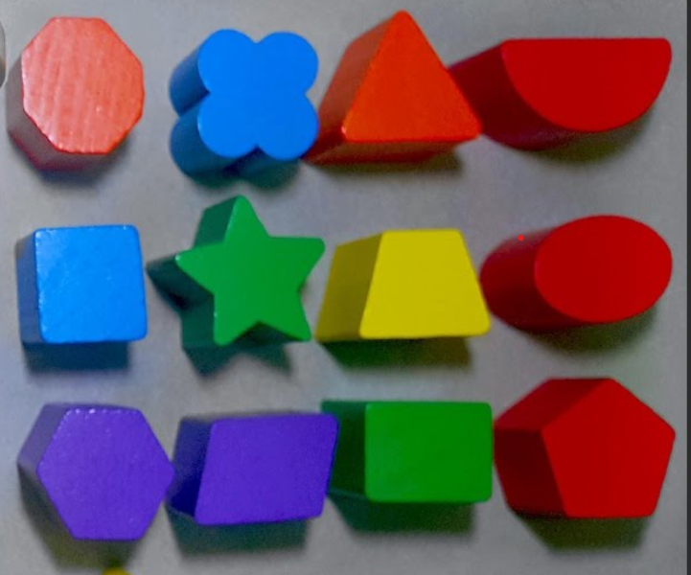
The goal of communication

Slide 35
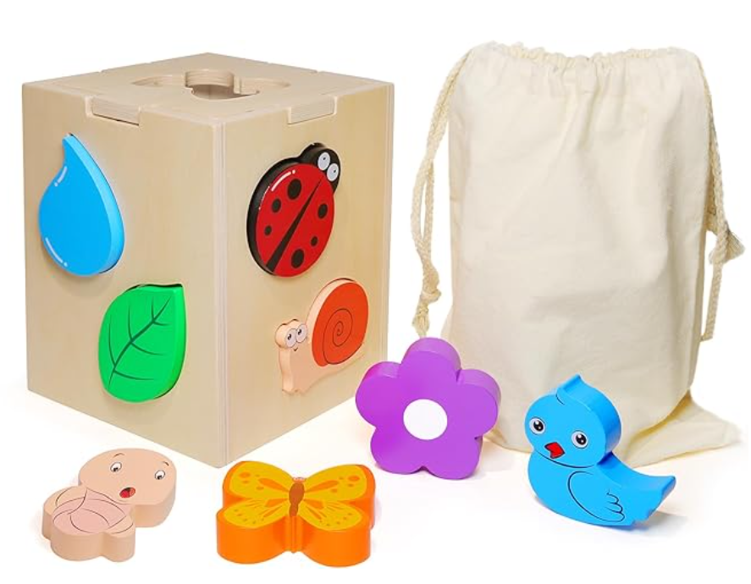
The goal of communication

Slide 36
The goal of communication

Slide 37
Myers-Briggs Type Indicator (MBTI)

Slide 38
Understand with Whom You Are Working
The 5 Languages of Appreciation in the Workplace: Empowering Organizations by Encouraging People
by Gary Chapman, Paul White
Acts of Service
Quality Time
Words of Affirmation
Tangible Gifts
Physical Touch
Notes:
But here is the workplace version
The things people will say or do
show clues to their love language ….
Knowing people’s languages of appreciation is critical
To trust
To team building
And you know the number one reason people leave a company is they don’t feel appreciated.

Slide 39
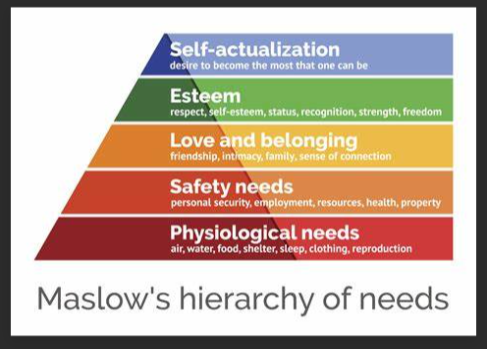
Understand with Whom You Are Working
Current Life Experiences
Performance
Critical
Elements
Notes:
Lets talk about Current Life Experiences – This is where your empathy can shine.
You never know what someone is dealing with.
Maslow’s hierarchy of Needs shows the critically needed elements on the bottom, as the base for all productivity.

Slide 40
Understand where you are You Are Working
Current Life Experiences
Performance
Critical
Elements
Notes:
Mountain top experiences are the good times – the seasons of happiness.
These times you feel strong, free, have great self-esteem,
And in these times, its easier to be creative, learn, engage with others – as I said, life is good.

Slide 41
Understand where you are You Are Working
Current Life Experiences
Performance
Critical
Elements
Notes:
Then there are the valleys – this is when everything on the mountain top seems far away
In fact, this is a season of lacking – you may feel lonely, scared, in danger, or ill.
These are the times when you may put on a brave face, but struggle.
If you find yourself LACKING in one of these critical areas, in a difficult season, it is so incredibly difficult to be productive.
Many put on a brave face and keep it together, but there may be some grace needed.
Business Analysis IS THE PEOPLE BUSINESS -
So if someone is not as productive as before, withdrawn somewhat or angry –
Assume Positive Intent
And
Be Kind

Slide 42
Who is Thea Soehren
Thea Soehren
President of the IIBA Tampa Bay, Florida Chapter
And
VP of Career and Professional Development
Founder of the BA Force Multiplier movement
Author of the Business Analysis Body of Knowledge v3
Business Analysis Bridging the Gap Between Industries
President of the Tampa Bay, Florida Chapter of the IIBA
Contact Thea through LinkedIn –
https://www.linkedin.com/in/TheaSoehren/

